Slide 1
Planning with Uncertainty
Ryan Spring
12/2/2014

Slide 2
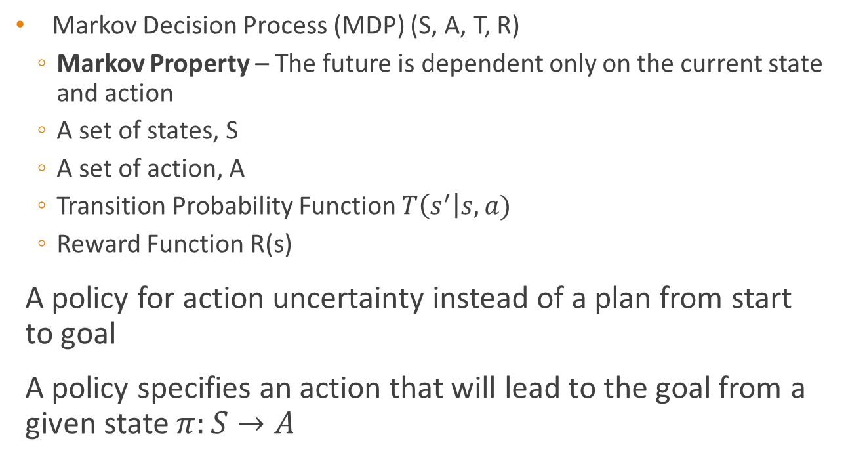
Introduction
Markov Decision Process (MDP) (S, A, T, R)
Markov Property – The future is dependent only on the current state and action
A set of states, S
A set of action, A
Transition Probability Function $T\left(s^{′}\right|s,a)$
Reward Function R(s)
A policy for action uncertainty instead of a plan from start to goal
A policy specifies an action that will lead to the goal from a given state $π:S→A$

Slide 3
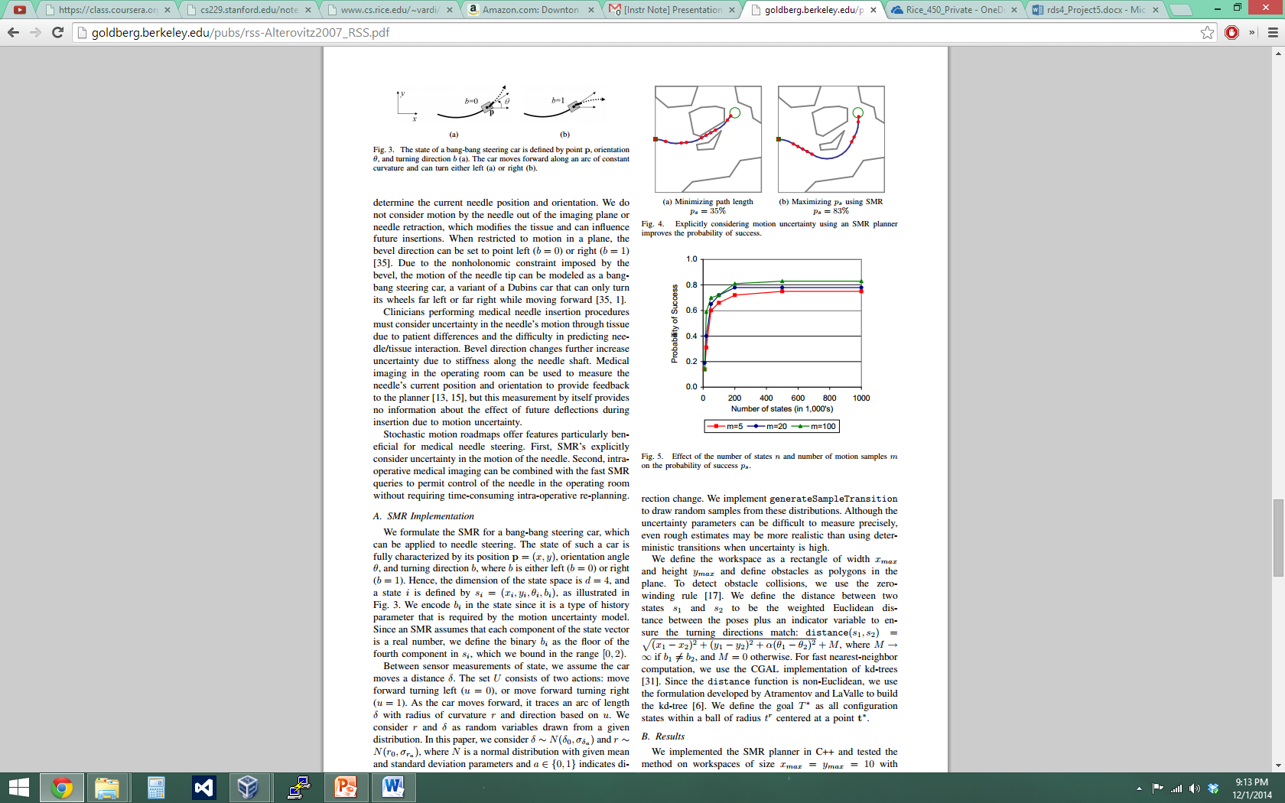
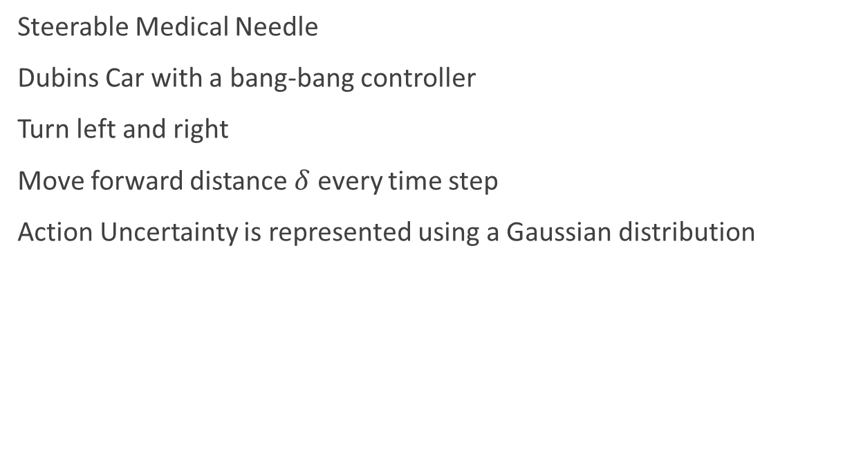
Problem
Steerable Medical Needle
Dubins Car with a bang-bang controller
Turn left and right
Move forward distance $δ$ every time step
Action Uncertainty is represented using a Gaussian distribution

Slide 4
Stochastic Motion Roadmap
Sample configuration space
Generate an approximation of the action uncertainty
MDP Value Iteration

Slide 5
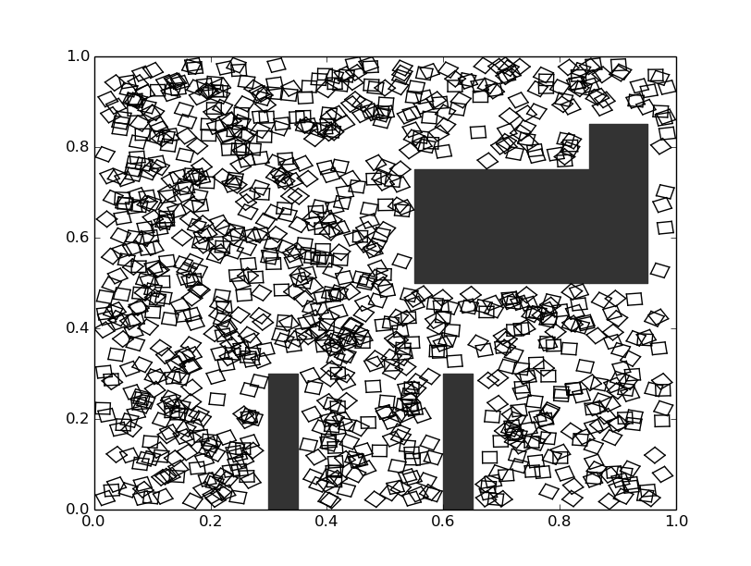
Build SMR Graph
Sample n states from the configuration space to form the vertices of the graph – n = 50,000

Slide 6
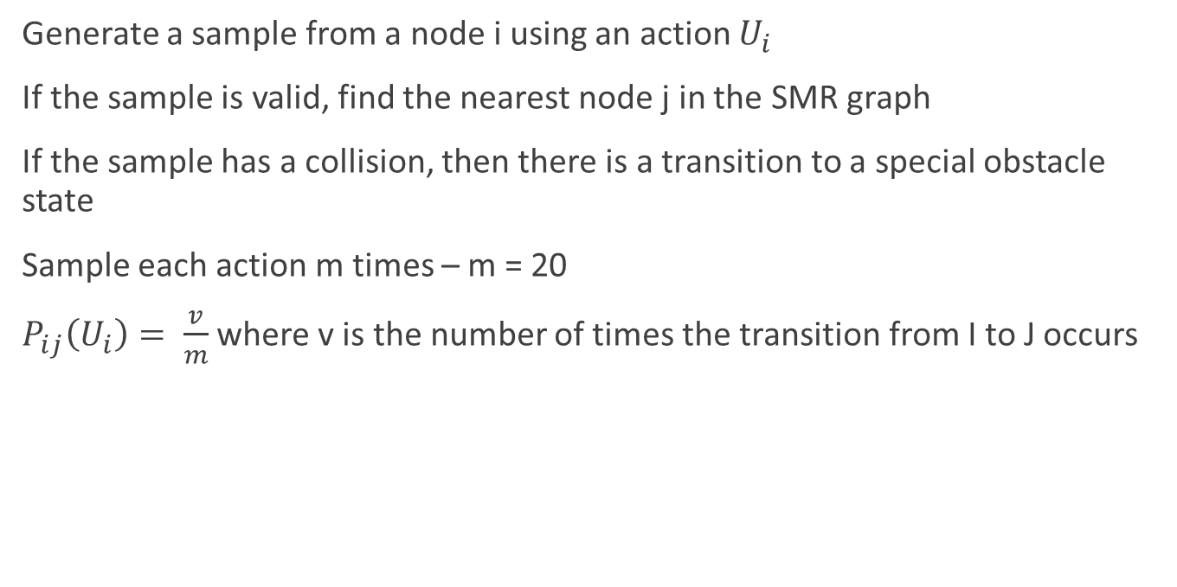
Transition Model
Generate a sample from a node i using an action $U_{i}$
If the sample is valid, find the nearest node j in the SMR graph
If the sample has a collision, then there is a transition to a special obstacle state
Sample each action m times – m = 20
$P_{ij}\left(U_{i}\right)= \frac{v}{m}$ where v is the number of times the transition from I to J occurs

Slide 7
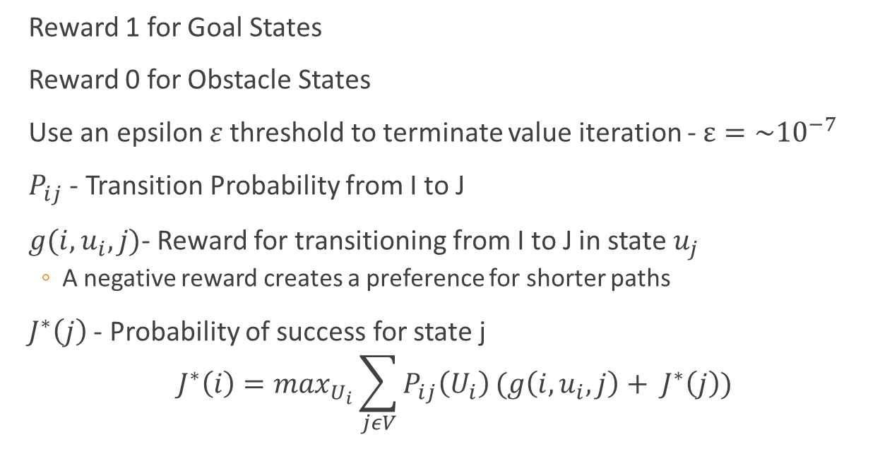
MDP Value Iteration
Reward 1 for Goal States
Reward 0 for Obstacle States
Use an epsilon $ε$threshold to terminate value iteration - $ε={\sim 10}^{−7}$
$P_{ij}$ - Transition Probability from I to J
$g(i,u_{i},j)$- Reward for transitioning from I to J in state $u_{j}$
A negative reward creates a preference for shorter paths
$J^{∗}\left(j\right)$ - Probability of success for state j
$$J^{∗}\left(i\right)=\max_{U_{i}}\sum_{jεV}{P_{ij}\left(U_{i}\right)}(g\left(i,u_{i},j\right)+ J^{∗}\left(j\right))$$

Slide 8
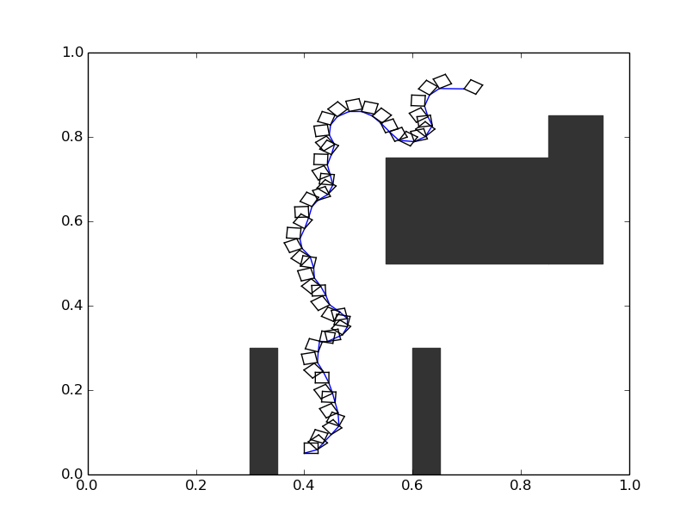
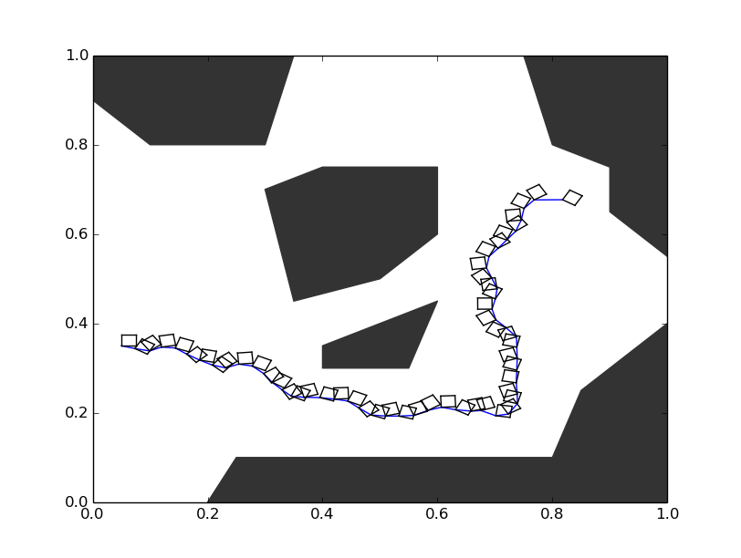
Results
Environment 1
Environment 3

Slide 9
Results

Slide 10
Extensions
The main bottleneck was creating the transition model and performing the MDP Value iteration
About 6x performance improvement with Multi-threaded Support

Slide 11
Motivation/Challenges
MDPs are everywhere!
i.e. Robotics, Machine Learning, Sensing, Control Theory
Sanity Check:
First, solve the problem without action uncertainty
Then, incrementally add uncertainty to the problem

